Slide 1
DevOps Industrial Training

Slide 2

Ansible

Slide 3
Agenda
Ansible Roles
Ansible Galaxy
Best Practices
Ansible Vault
Examples

Slide 4
Handlers
Sometimes you want a task to run only when a change is made on a machine.
For example, you may want to restart a service if a task updates the configuration of that service, but not if the configuration is unchanged.
Ansible uses handlers to address this use case.
Handlers are tasks that only run when notified.
Notifying handlers
Tasks can instruct one or more handlers to execute using the notify keyword.
The notify keyword can be applied to a task and accepts a list of handler names that are notified on a task change.
Alternately, a string containing a single handler name can be supplied as well. The following example demonstrates how multiple handlers can be notified by a single task.
Naming handlers
Handlers must be named in order for tasks to be able to notify them using the notify keyword.

Slide 5
Types of Ansible
Ansible – core
  Opensource
  Command line
  Ansible Tower
    Licensed
    UI
    Backend- core

Slide 6
Roles & Ansible-Galaxy
A role is an Ansible approach for bundling automation content and making it reusable.
It is an arrangement of files in a predefined folder structure that will load certain variable files, tasks, handlers automatically during the process execution.
Roles allow you to create very simple playbooks and which then look to a directory structure to identify the actual configuration steps they need to perform.
Grouping content of the code in this format will help to manage large pieces of codes in complex deployments in a more user friendly manner.
Ansible roles also facilitate the easy sharing and reuse of the scripts with other users.

Slide 7
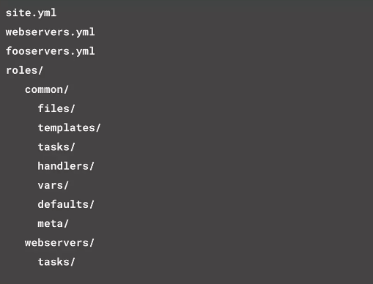
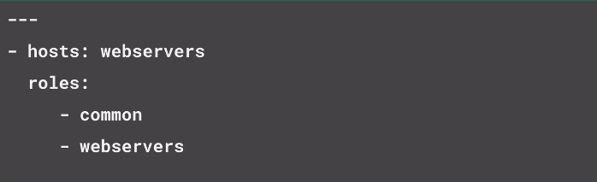
Roles
Roles are portable units of task organization in playbooks and is the best way to organize your playbooks.
Roles are just automation around ‘include’ directives, and really don’t contain much additional magic beyond some improvements to search path handling for referenced files.

Slide 8
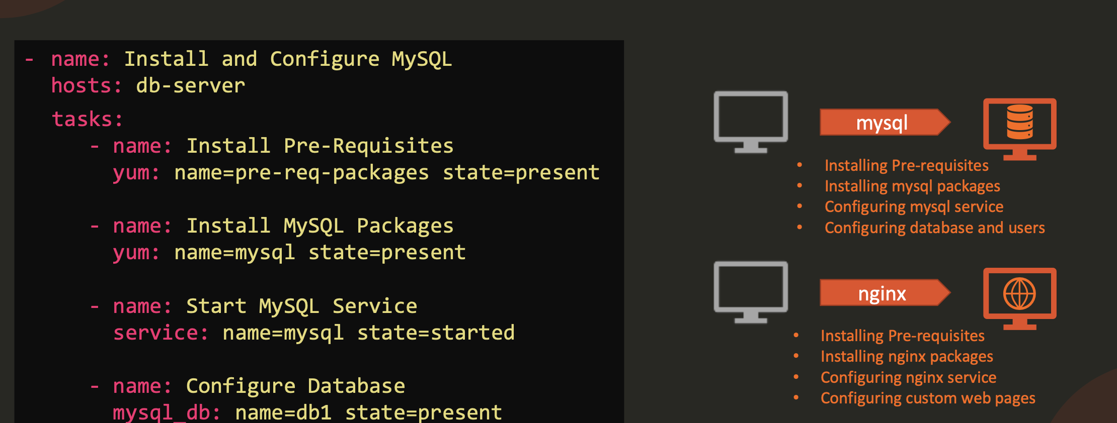
Roles

Slide 9

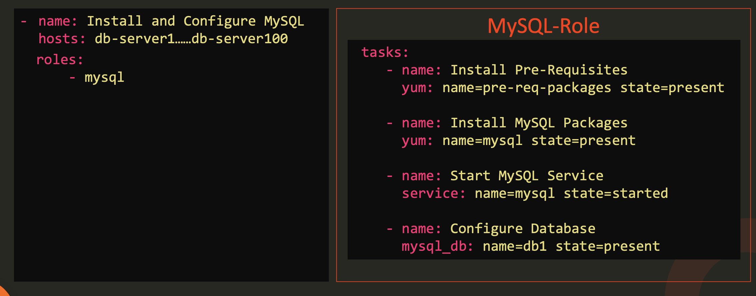
Roles
Reuse

Slide 10

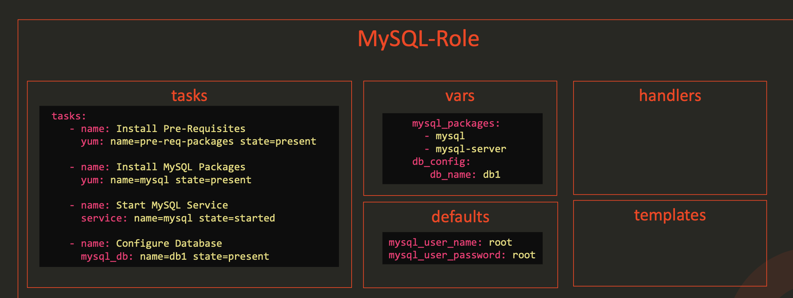
Organize

Slide 11
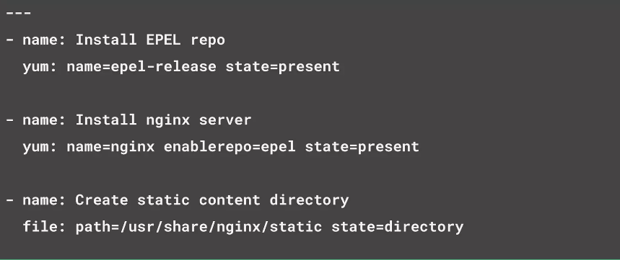
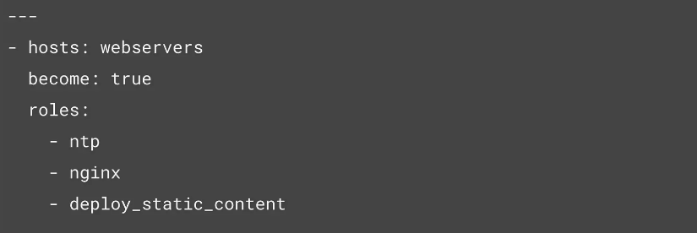
Example Role
Install the ntp service & nginx server on webservers and deploy static content

Slide 12
Install Nginx & JDK & MongoDB with in Roles
Install ntp service on all servers
Install the nginx server on webservers
Deploy static content on webservers
Install JDK on appservers
Install MongoDB on dbservers

Slide 13
Introduction - Ansible Galaxy
Official Ansible roles repository
Released in 2014
Published to open source in 2014
~15000 community roles imported
Relies on github as content provider

Slide 14
What is Ansible Galaxy
ansible-galaxy
Comes bundled with Ansible
Installs roles from Galaxy directly
Or from Git
Manage roles on the Galaxy website
Ansible Galaxy is a repository where users can share and fetch roles.
Ansible Galaxy promotes reusable roles for server configuration.
It is very common to use Ansible Galaxy in a project.
Roles are a way of breaking bigger playbooks into a systematic structure.
We can modify our own roles and use them accordingly.
You can view more of these roles by visiting this galaxy https://galaxy.ansible.com/

Slide 15
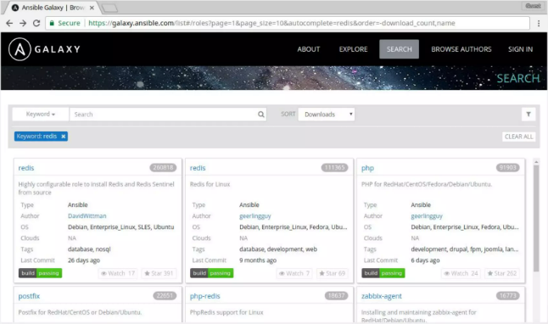
Using Ansible Galaxy
Search Roles : https://galaxy.ansible.com/search?deprecated=false&tags=system&keywords=&order_by=-relevance

Slide 16
Download & Install Roles from Ansible Galaxy
Install a role:
ansible-galaxy install username.rolename
Install to custom roles path directory:
ansible-galaxy install --roles-path . username.rolename
Install from requirements.yaml file:
ansible-galaxy install –r requirements.yaml

Slide 17
Download and Install Roles from any git-based SCM
ansible-galaxy install git+https://github.com/acme/role.git,v1.2.0

Slide 18
Download and Install Roles requirements.yaml format
# from Galaxy
src: bennojoy.nginx
# from Github
src: https://github.com/bennojoy/nginx
# from Gitlab or other git-based SCM
src: git@gitlab.acme.com:mygroup/ansible-base.git
scm: git
version: “0.1”

Slide 19
Create role
Use the init command to initialize the basic structure of a new role:
ansible-galaxy init rolename
Using a custom role skeleton
ansible-galaxy init --role-skeleton=/path/to/skeleton/role_name

Slide 20
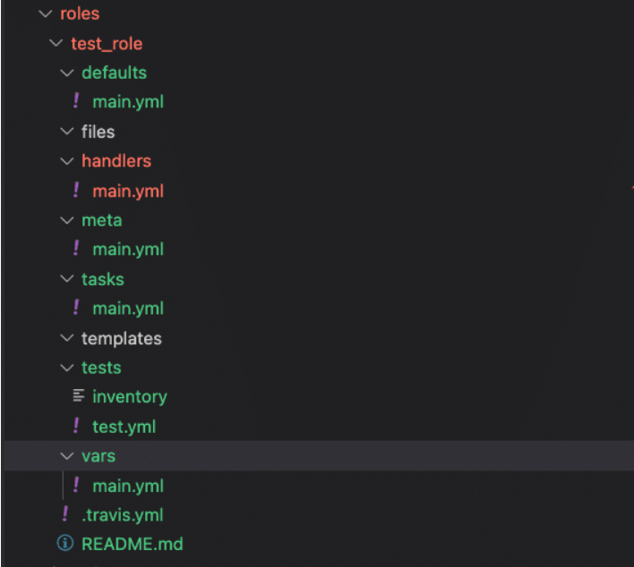
Role structure
defaults – Includes default values for variables of the role. Here we define some sane default variables, but they have the lowest priority and are usually overridden by other methods to customize the role.
files – Contains static and custom files that the role uses to perform various tasks.
handlers – A set of handlers that are triggered by tasks of the role.
meta – Includes metadata information for the role, its dependencies, the author, license, available platform, etc.
tasks – A list of tasks to be executed by the role. This part could be considered similar to the task section of a playbook.
templates – Contains Jinja2 template files used by tasks of the role.
tests – Includes configuration files related to role testing.
vars – Contains variables defined for the role. These have quite a high precedence in Ansible.

Slide 21
Ansible Roles Example
https://github.com/IBT-learning/ansible-roles-example
Ansible Playbooks Examples
https://github.com/truewebartisans/useful-playbooks
https://github.com/lvl3/ansible-skeleton
https://github.com/syedsaadahmed/Ansible-Playbook-Samples/blob/master/reboot_server/playbook.yml
https://github.com/opensearch-project/ansible-playbook/tree/main/roles/linux

Slide 22
Ansible Vault
Having infrastructure as code can pose the threat of exposing your sensitive data to the world, leading to unwanted security issues.
Ansible Vault is a feature that allows you to keep all your secrets safe.
It can encrypt entire files, entire YAML playbooks or even a few variables.
It provides a facility where you can not only encrypt sensitive data but also integrate them into your playbooks.
Vault is implemented with file-level granularity where the files are either entirely encrypted or entirely unencrypted.
It uses the same password for encrypting as well as for decrypting files which makes using Ansible Vault very user-friendly.

Slide 23
Why use Ansible Vault ?
As Ansible is being used for automation, there is a high possibility that playbooks contain certain credentials, SSL certificates or other sensitive data.
Saving such sensitive data as plain text is a bad idea.
One wrong commit to GitHub or laptop theft can cause an organization a huge loss.
This is where Ansible vault comes into the picture.
It is a great way of having infrastructure as code, without compromising on the security.
Suppose, we have a playbook that provisions your EC2 instance on AWS.
You need to provide your AWS access key id and AWS secret key in the playbook.
You do not share these keys with others for obvious reasons.
How do you keep them unexposed?
There are two ways — Either encrypt these two variables and embed them into the playbook or encrypt the entire playbook.
This was just one of the scenario where ansible vault can be used.
We can either encrypt entire files or just encrypt few variables which might hold sensitive data and then Ansible automatically decrypts them during runtime. Now we can safely commit these values to GitHub.

Slide 24



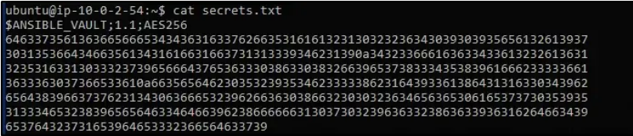
Creating Encrypted File
To create an encrypted file, use the ansible-vault create command and pass the filename.
You’ll be prompted to create a password and then confirm it by re-typing it.
Once your password is confirmed, a new file will be created and will open an editing window. By default, the editor for Ansible Vault is vi. You can add data, save and exit.
And your file is encrypted.

Slide 25

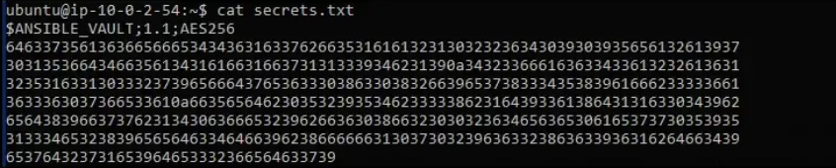
Editing Encrypted File
If you want to edit an encrypted file, you can edit it using ansible-vault edit command.
Where secrets.txt is an already created, encrypted file.
You’ll be prompted to insert the vault password.
The file(decrypted version) will open in a vi editor and then you can make the required changes.
If you check the output, you’ll see your text will be encrypted automatically when you save and close.

Slide 26

Viewing Encrypted File
If you wish to just view an encrypted file, you can use the ansible-vault view command
Again you’ll be prompted for a password.
and you’ll see similar output.

Slide 27
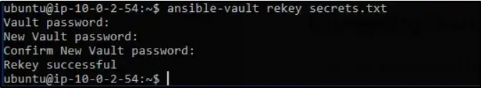
Rekeying Encrypted File
Of course, there are times where you’ll want to change the vault password.
You can use the ansible-vault rekey command.
You’ll be prompted with the vault’s current password and then the new password and finally done by confirming the new password.

Slide 28

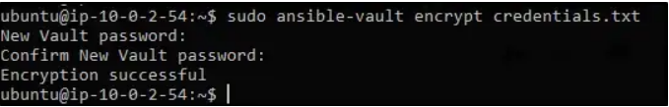
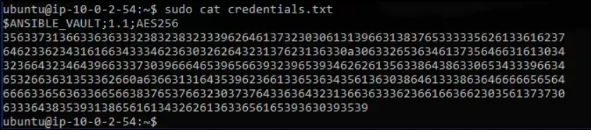
Encrypting Unencrypted Files
Suppose you have a file which you wish to encrypt, you can use the ansible-vault encrypt command.
You’ll be prompted to insert and confirm password and your file is encrypted.
Now that you look at file contents, its all encrypted.

Slide 29

Decrypting Encrypted Files
If you want to decrypt an encrypted file, you can use ansible-vault decrypt command
As usual, it’ll prompt you to insert and confirm the vault password.

Slide 30

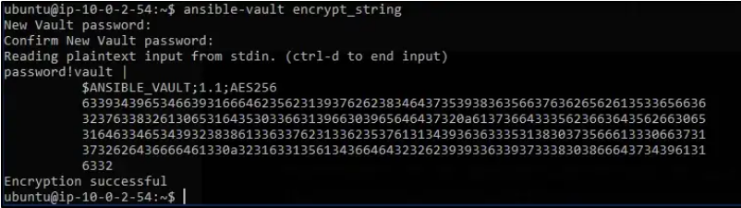
Encrypting specific variables
Best practice while using Ansible Vault is to encrypt only the sensitive data.
In the example explained above, the development team does not want to share their password with the production and the staging team but they might need access to certain data to carry out their own task.
In such cases you should only be encrypting the data you do not want to share with others, leaving the rest as it is.
Ansible Vault allows you to encrypt only specific variables. You can use the ansible-vault encrypt_string command for this.
You’ll be prompted to insert and then confirm the vault password.
You can then start inserting the string value that you wish to encrypt.
Press ctrl-d to end input. Now you can assign this encrypted value to a string in the playbook.

Slide 31

Decrypting Encrypted Files During Runtime
If you wish to decrypt a file during runtime, you could use –ask-vault-pass flag.
This will decrypt all the encrypted files that are used for this launch.yml playbook to execute. Also, this is only possible if all the files are encrypted with the same password.
Password prompts can get annoying. The purpose of automation becomes pointless.
How do we make this better?
Ansible has a feature called “password file” which references to a file containing the password. You can then just pass this password file during runtime to automate it.
Having a separate script that specifies the passwords is also possible.
You need to make sure the script file is executable and the password is printed to standard output for it to work without annoying errors.

Slide 32
Using Vault Id
Vault Id is a way of providing an identifier to a particular vault password.
Vault ID helps in encrypting different files with different passwords to be referenced inside a playbook.
This feature of Ansible came out with the release of Ansible 2.4.
Prior to this release, only one vault password could be used in each ansible playbook execution.
So now if you wish to execute an Ansible playbook which uses multiple files encrypted with different passwords, you can use Vault Id.

Slide 33
Using Password with Playbook
When all data is encrypted using a single password the --ask-vault-pass or --vault-password-file cli options should be used.
For example, to use a password store in the text file /path/to/my/vault-password-file:
ansible-playbook --vault-password-file /path/to/my/vault-password-file site.yml
To prompt for a password:
ansible-playbook --ask-vault-pass site.yml
To get the password from a vault password executable script my-vault-password.py:
ansible-playbook --vault-password-file my-vault-password.py

Slide 34

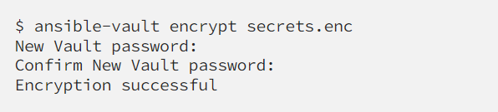
Using Password with Playbook
---
- name: Update Config
hosts: localhost
connection: local
vars_prompt:
- name: api_key
prompt: Enter the API key
tasks:
- name: Add API key to thes config file
lineinfile:
path: ~/config.ini
line: "API_KEY={{ api_key }}"
Encrypt the file with ansible-vault

Slide 35
Reusing ansible playbooks
The main difference is:
All import* statements are pre-processed at the time playbooks are parsed.
All include* statements are processed as they encountered during the execution of the playbook.
use import when you deal with logical "units". For example, separate long list of tasks into subtask files:
main.yml:
- import_tasks: prepare_filesystem.yml
- import_tasks: install_prerequisites.yml
- import_tasks: install_application.yml
But you would use include to deal with different workflows and take decisions based on some dynamically gathered facts:
install_prerequisites:
include_tasks: prerequisites_{{ ansible_os_family | lower }}.yml
- name: Include task list in play only if the condition is true
include_tasks: "{{ hostvar }}.yaml"
when: hostvar is defined
https://docs.ansible.com/ansible/latest/user_guide/playbooks_reuse.html#playbooks-reuse

Slide 36
Best Practices

Slide 37
Complexity Kills
Optimize for readability
Think declaratively

Slide 38
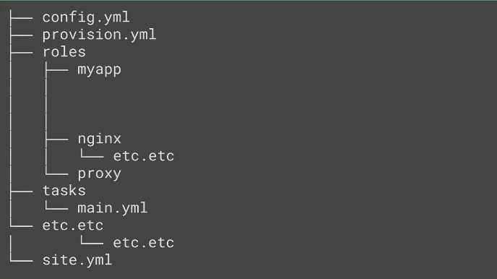
Project Layout

Slide 39
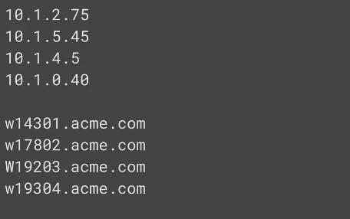
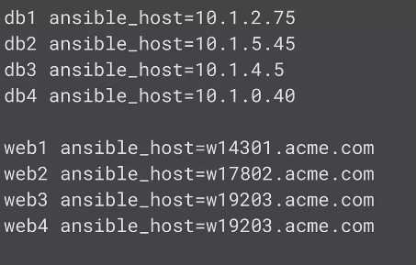
Meaningful Inventory Names

Slide 40
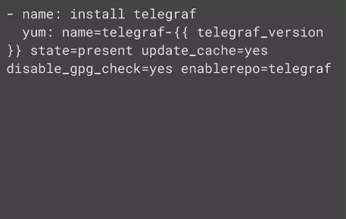
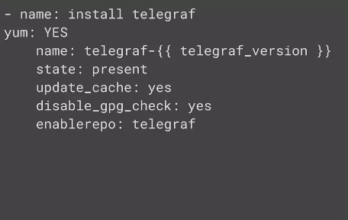
Vertical Reading is Easier

Slide 41
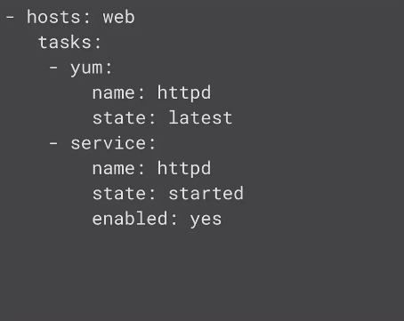
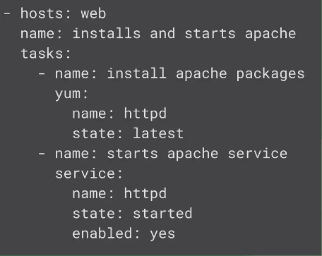
Meaningful Task Names

Slide 42
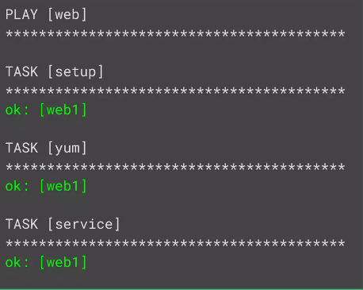
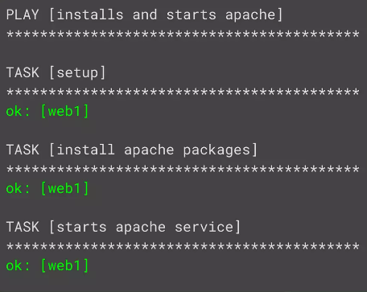
Meaningful Task Names

Slide 43
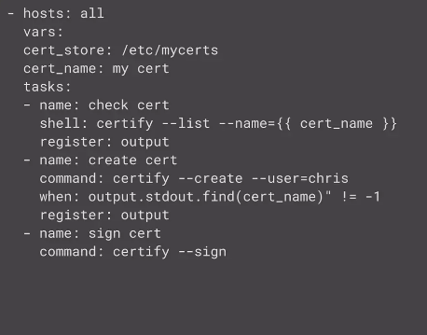
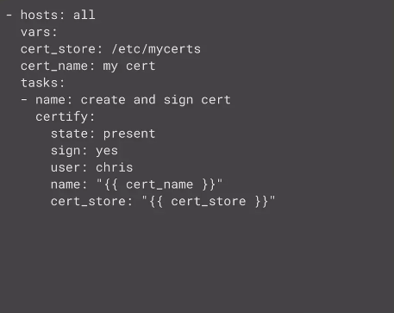
Consider Writing a Module

Slide 44
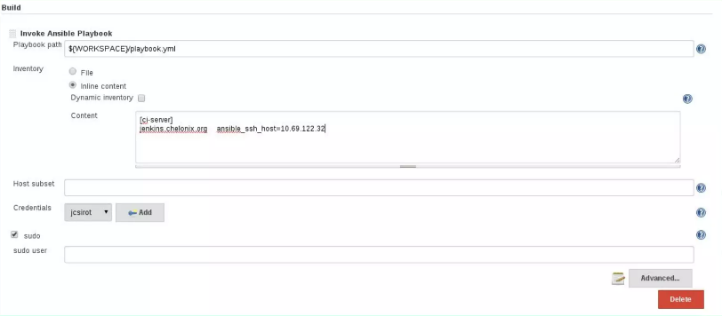
Continuous Integration with Ansible
Jenkins Ansible Plugin
https://wiki.Jenkins-ci.org/display/JENKINS/Ansible+Plugin

Slide 45
Quiz
What language is an Ansible playbooks are written in by default?
YAML format
JSON format
XML format
HTML format

Slide 46
Quiz
What language is an Ansible playbooks are written in by default?
YAML format
JSON format
XML format
HTML format

Slide 47
Quiz
Which command will you use to run a playbook called install.yaml with Ansible?
ansible-playbook install.yml
ansible install.yml
ansible --playbook install.yml
ansible -p install.yml

Slide 48
Quiz
Which command will you use to run a playbook called install.yaml with Ansible?
ansible-playbook install.yml
ansible install.yml
ansible --playbook install.yml
ansible -p install.yml

Slide 49
Quiz
Which argument will you use to specify a variable for your Ansible playbook?
-v
-e
-c
-a

Slide 50
Quiz
Which argument will you use to specify a variable for your Ansible playbook?
-v
-e
-c
-a

Slide 51
Quiz
Ansible playbooks are the basis for a really simple configuration management and multi-machine deployment system, unlike any that already exist, and one that is very well suited to deploying complex applications.
false
true

Slide 52
Quiz
Ansible playbooks are the basis for a really simple configuration management and multi-machine deployment system, unlike any that already exist, and one that is very well suited to deploying complex applications.
false
true

Slide 53
Quiz
What does 'become: yes' mean in Ansible playbooks?
It means that the command must be retried until it succeeds
It means that the service needs to be started once installed
It means that the worker node should become a manager node
It means that we would run all commands as root

Slide 54
Quiz
What does 'become: yes' mean in Ansible playbooks?
It means that the command must be retried until it succeeds
It means that the service needs to be started once installed
It means that the worker node should become a manager node
It means that we would run all commands as root

Slide 55
Interview Questions
How does ansible connects to managed nodes?
Do I need to have ansible installed on all the managed nodes?
Which modules in ansible have you used?
How do you test an ansible playbook?
How do you perform error handling in ansible playbook?
Can I run ansible against windows servers?
Give few use cases of ansible?

